Slide 1
Original EMOSA specification
alternative EMOSA specification
Hybrid
Contagion
Diffusion

Slide 2
Original EMOSA specification
alternativePlus EMOSA specification
Hybrid
Contagion
Diffusion

Slide 3
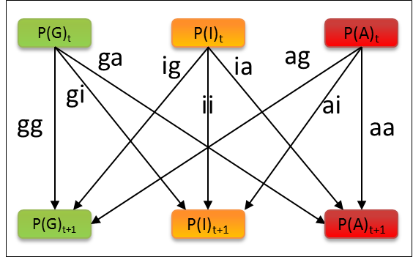
NewDiffusion
NewContagion
NewHybrid

Slide 4
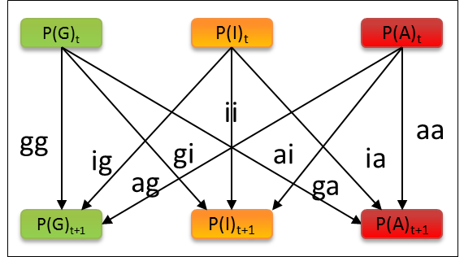
9 Transitions
Diffusion
Contagion
6 Pairings

Slide 5
9 Transitions
Diffusion
Contagion
6 Pairings

Slide 6
9 Transitions
Diffusion
Contagion
6 Pairings

Slide 7
9 Transitions
6 Pairings

Slide 8
.6
.3
.1
P(G)_{t}
P(I)_{t}
P(A)_{t}
P(G)_{t}
P(I)_{t}
P(A)_{t}
.36
.09
.01
ii
gg
aa
.18
.18
.03
.03
ig
gi
ai
ia
.06
.06
ag
ga
P(G)_{t+1}
P(I)_{t+1}
P(A)_{t+1}
P(G)_{t+1}
P(I)_{t+1}
P(A)_{t+1}
.36
.09
.01
.36
.06
.12
.46
.54
1

Slide 9
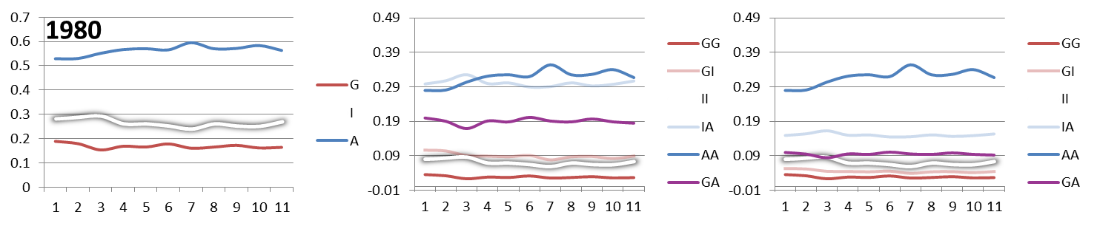

Slide 10
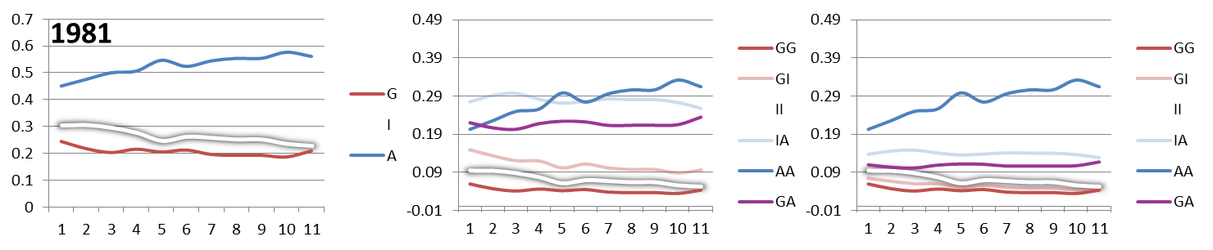

Slide 11
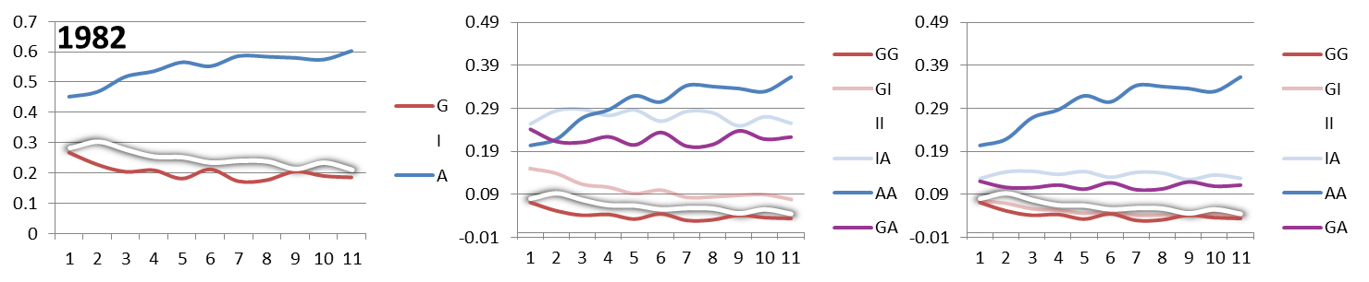

Slide 12
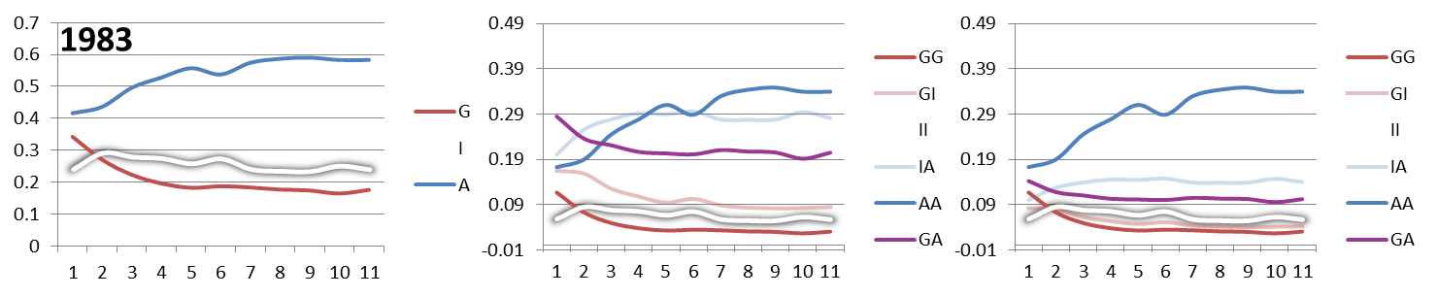

Slide 13
